Slide 1
Flavours of IOT Services

Slide 2


Good Morning Friends
Flavors of IOT services
Lets start with today’s topic

Slide 3


Objective
By End Of This Session
01
IOT Solution flavour
02
Customers under these services
03
Detailed Resolutions
04
TAT

Slide 4

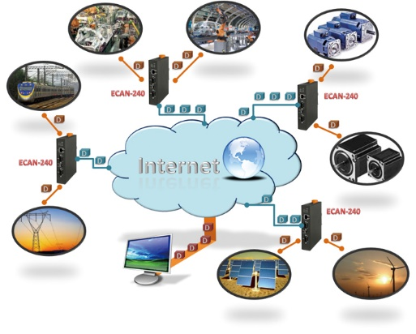
The Internet of things (IoT) is a system of interrelated computing devices, mechanical and digital machines, objects that are provided with unique identifiers (UIDs) and the ability to transfer data over a network without requiring human-to-human or human-to-computer interaction
An IoT ecosystem consists of web-enabled smart devices that use embedded processors, sensors and communication hardware to collect, send and act on data they acquire from their environments. ... Sometimes, these devices communicate with other related devices and act on the information they get from one another.

Slide 5
IOT Solution flavours
1. Open Internet APN (WWW)
2. Private Mass Market APN with restricted internet access
IOT.COM
IOTURL.COM
ISAFE
3. Private APN with IP Whitelisting (IOT.SUKAM.COM)
4. Private APN with IP & URL Whitelisting (BAJAJSAATHI.COM)
5. Private APN with MPLS (GPRSNAC.COM)
6. Private APN with static IP via EC-AAA (M2M.NELCO.COM)
7. Private APN with CSD DATA (TAGAPN)
8. Private APN IP Whitelisting with GDSP Sim Management (m2m.asjr.com)
9. Private APN IP +URL Whitelisting with GDSP Sim Management (M2M.OIZOM.COM)
10.Private APN with static IP via GDSP-AAA
11. Private APN with IPSEC connectivity
12.Private APN with Dual profile sims

Slide 6
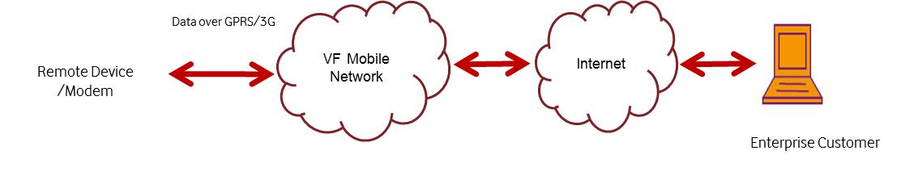
Open Internet APN (WWW)
GPRS/3G is most preferred and used communication medium for IOT solution. It provides reliability and required bandwidth for transferring data between machines at nominal rates. This requires GPRS/3G services to be enabled on IOT SIMs. In this solution customer uses generic open internet APNs for transmitting data from remote machines.
In this Solution service there is no whitelisting, User can surf over internet.
No security checks required
No Provisioning from RM
WWW

Slide 7
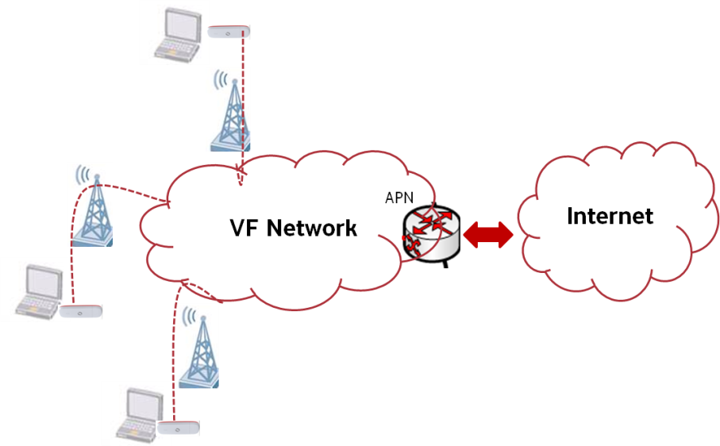
IOT – Private APN with restricted internet access
In this solution a customer can use Private APN for connecting to internet with restricted access. Customer provides IPs and Ports which shall be white listed to Vodafone. While providing SIM cards Vodafone disables VMC (Vodafone Mobile Connect) or Vodafone Live services and activates only Private APN service.
Sample Use Cases: Vodafone Customer provides Vehicle Tracking Solution to their customers. Customer wants that Vodafone SIM used for Vehicle Tracking shall only be allowed to use GPRS/3G for sending data to Backend Server IP XX. XX. XX. XX/URL. Vodafone needs to whitelist the Required Server IPs /URL at core network nodes in order to achieve the above Requirement.
This is known as MASS MARKET because it can be used by large count of customers
M2M IOT dedicated
IOT.COM
IOTURL.COM
ISAFE

Slide 8
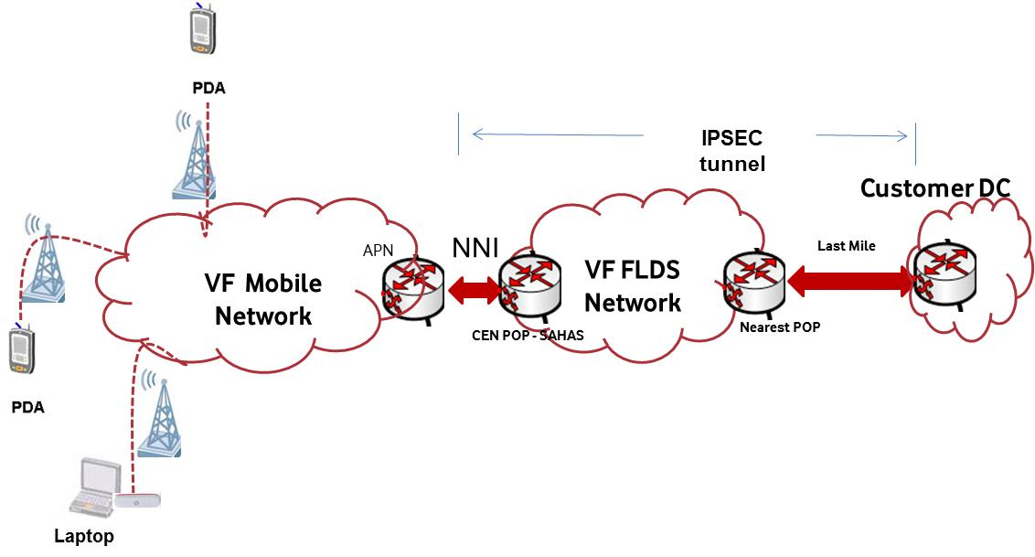
IOT – Private APN with IPSEC
In this solution a point to point connectivity is established between Vodafone Network and Customer Data Centre for secured data transfer using IPSEC tunnel.
The Enterprise Customer is provided with a dedicated Private APN (Access Point Name). The APN name will be used by enterprise 3G/GPRS/EDGE devices to access the M2M Application. The APN would be configured to allocate IP Addresses to the Enterprise Customers’ group of mobile 3G/GPRS/EDGE users. The number of IP Addresses reserved on the Vodafone network could be proportional to the number of SIM cards procured by the Enterprise Customer and concurrency required.
The APN is made to be a part of the VRF in which the Enterprise Customers’ IPSEC Tunnel would be terminated. This ensures end to end security for the mobile 3G/GPRS users. Thus, IP connectivity will be established from the mobile 3G/GPRS user handset up to the Enterprise Data Centre over the Internet
The IPSEC Tunnel terminates on the Vodafone Site Router and is configured under an isolated & dedicated routing table [VRF] which will not be accessible from the Internet or by any other customer. The VRF is a database of the Enterprise Customers’ IP Addresses. The Internet will be used by the Enterprise Customer to reach the Vodafone 3G/GPRS Router. The IPSEC Tunnel would be terminated in the VRF for that particular Enterprise Customer. Thus, to be able to reach the VRF of the customer, the data traffic will have to traverse through the IPSEC Tunnel, hence keeping the VRF completely secure from the Internet and any other customer.
In this solution a point to point connectivity is established between Vodafone Network and Customer Data Centre for secured data transfer using MPLS.
The data need to be further protected with IPSEC encryption created from GGSN/NNI Router and over the traffic to MPLS link. MPLS carries the traffic to a router in customer premises Router is connected to “3rd party Firewall” of customer in Data Centre of Customer. IPSEC is terminated on “3rd party Firewall” of customer

Slide 9
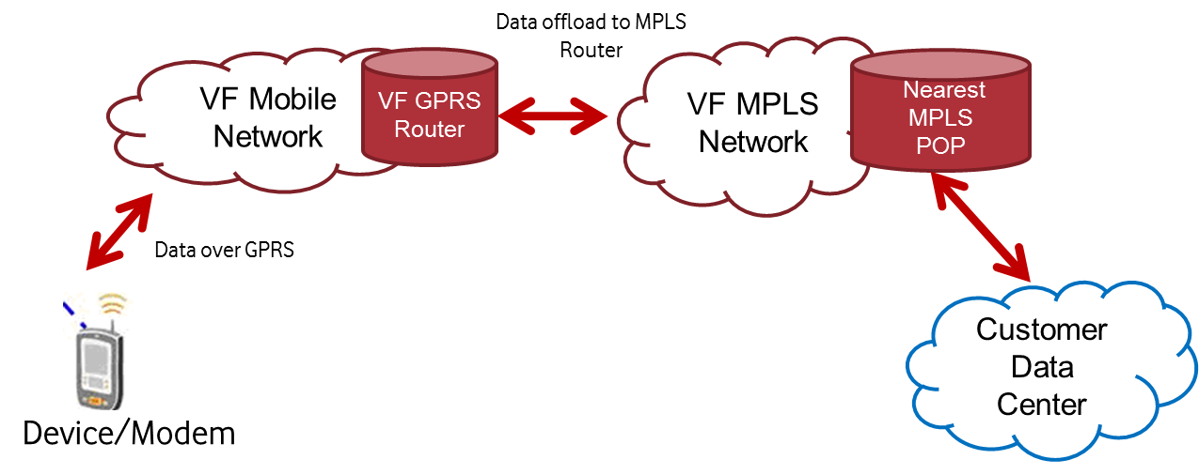
IOT – Private APN with MPLS
In this solution a point to point connectivity is established between Vodafone Network and Customer Data Centre for secured data transfer using MPLS.
The Enterprise Customer can procure MPLS connectivity from Vodafone and have one end terminated on a router (customer owned & managed) at their Data Centre. Vodafone will terminate the MPLS appropriately on the Vodafone MPLS CEN POP.
IOT – Private APN with MPLS & CPE.
It’s the same solution as mentioned above in point number 2.5. Only CPE needs to be taken care by Vodafone Team. (Both HW and SW)

Slide 10
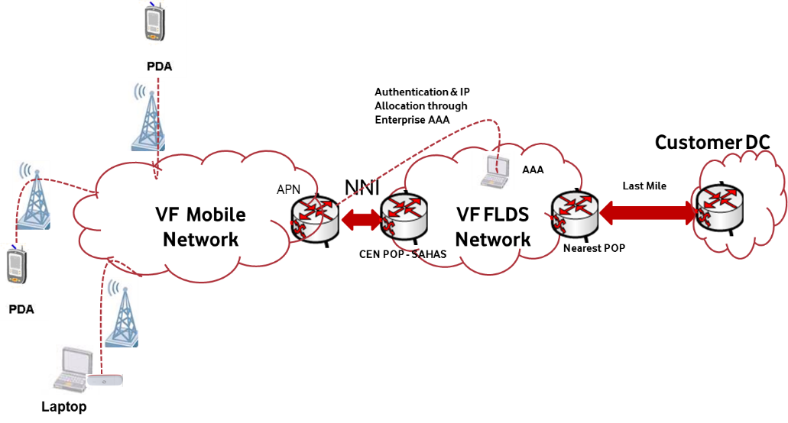
IOT– Private APN and static IP
In Static IP solution a SIM (IMSI, IMEI, SIM Number or Mobile Number) is mapped with Private Static IPs (Customer provided or Vodafone provided). Therefore, whenever SIM establishes GPRS/3G data connection through Corporate APN it is assigned the same static IP as per configuration. Private Static IP solution primarily is required for solutions where there is need of two-way communication with unique identification of each remote asset. Here IP assignment is being done by ECAAA solution. GGSN has dependency with ECAAA node.
Generally, in this solution Last Mile used can be Leased Line, MPLS or IPSEC. Also, it is possible that multiple device communicates with each other without last mile being part of same VRF, in such cases, remote device and remote server both have SIM card connected to Vodafone GPRS/3G network for communication with each other.
ECAAA- Server where Static IP
Here IP always remains same
These are the services where in Rural areas Fixed line services are not yet reached. EX ATM machines

Slide 11
IOT – Private APN with CSD Data
Circuit Switch Data communication uses voice channels for transmitting data. CSD is primarily used where bandwidth required is less and reliability required is high. This requires Voice and CSD (Data & Fax) services enabled on M2M SIMs.
In this solution along with Mobile Number a Data Number is associated with each SIM which is generally provided by Switch Team. SIM are inserted into PSTN/Dial-up modems at both sides (remote machines & server applications) for initiating a data call and data transmission over the voice channel.
Following schematic shows a typical example of CSD communication used in Automatic Meter Reading M2M solution. AMR Dialer application (Master SIM) periodically dials remote modems (Slave SIMs) for collecting the meter reading.

Slide 12
IOT – Private APN GDSP
GDSP is a kind of platform Server where User can track SIM activity, last transaction details, SIM state by accessing the GUI Portal. he can change the SIM plans as per his requirement. GDSPAAA server also can be used to assign static IP as per the solution requirement.

Slide 13
Thank you !

